Slide 1

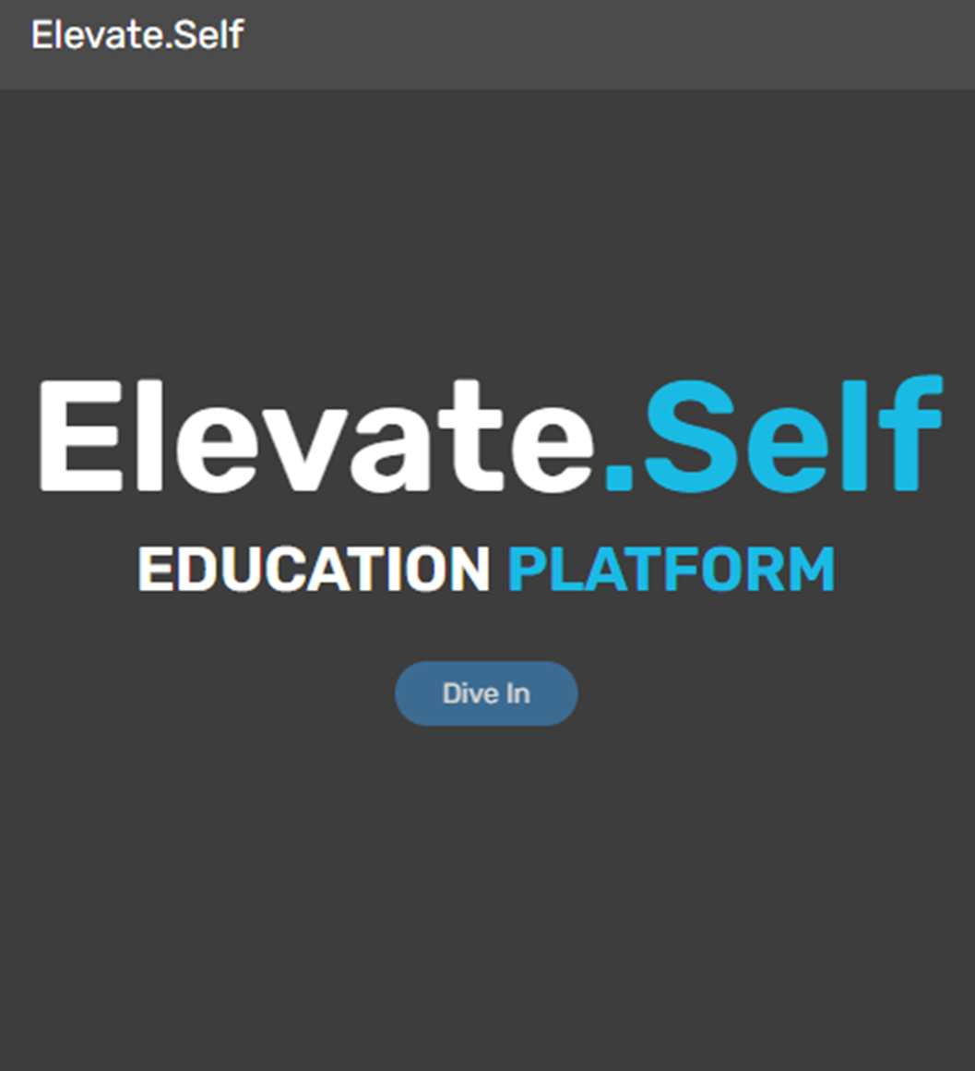

Elavate.Self
It is a fully information technology website that in intended to support the growth of IT professionals and students. Elavate Self is a nonprofit platform that will supply the users with free valuable IT related knowledge to improve the overall shortage of the profession.
We are dedicated improving the Educational awareness of users

Slide 2
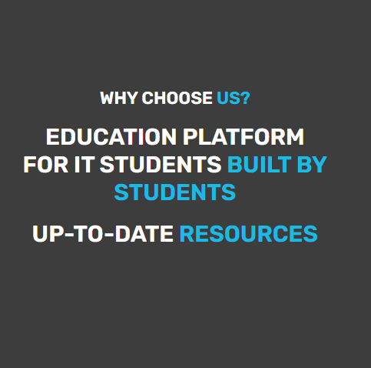


Problem VS Solution
A lack of AWARENESS of, ACCESS to & general SUPPORT for INFORMATION TECHNOLOGY related courses that are not implemented in secondary education of the country.
At SELF.ELAVATE we aim to introduce a solution that will improve the South African IT industry by providing access to better foundational knowledge and more entrants to the technological world.
Since the world is moving to the fourth industrial revolution we saw it fit to create solution that will be more flexible and not demanding physical collaboration to reach our goal
The solution was to create a web that will motivate and allow IT interested individuals to connect and get free resources of this sector to improve the overall capacity of IT proffesionals by online consultant help and offering the resources they need for free.

Slide 3
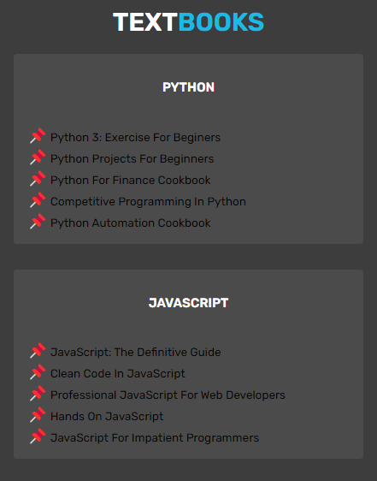
Narrative
It’s a website designed by students for students to pursue IT related fields that can assist them to improve their knowledge in IT. The platform will offer resources such as textbooks, GitHub repositories, links for educational API’s, bursaries and external assistance page and different tutors.
The users will be urged to sign up with their Username, Email and create a password if the user already has an account they must sign in with their credentials. After logging in the user will be directed to the home page where they will see different tabs such as the textbook, resources, tutors and the contact tab.

Slide 4

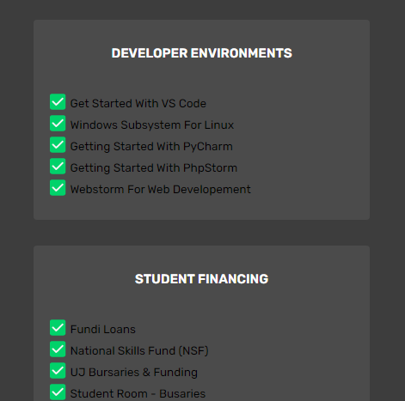
Narrative…
The Home Page will have a Dive In button when the user clicks it will direct to the Textbook Page.
The Textbook Page will contain different books related to IT and science such as Python, JavaScript, Web development, Cybersecurity, Software Engineering, Data Science.
The Student Resources page will contain the student financing bursaries, GitHub repositories and developer environment setup guide.
The website will have a Contact Us Page where the user will enter their credentials and select the course, they need help with from the tutors.

Slide 5
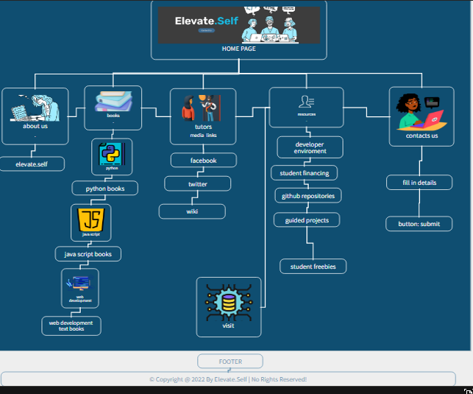

Slide 6
